Slide 1
city project
low poly blender project

Slide 2
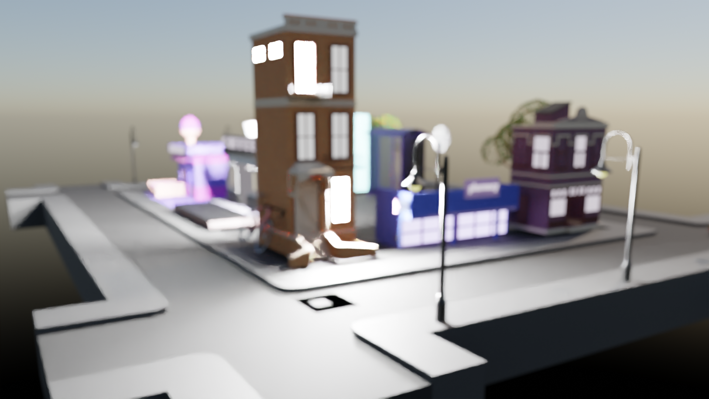
Taken by nada

Slide 3
Some shots of our city
Small videos we rendered

Slide 4
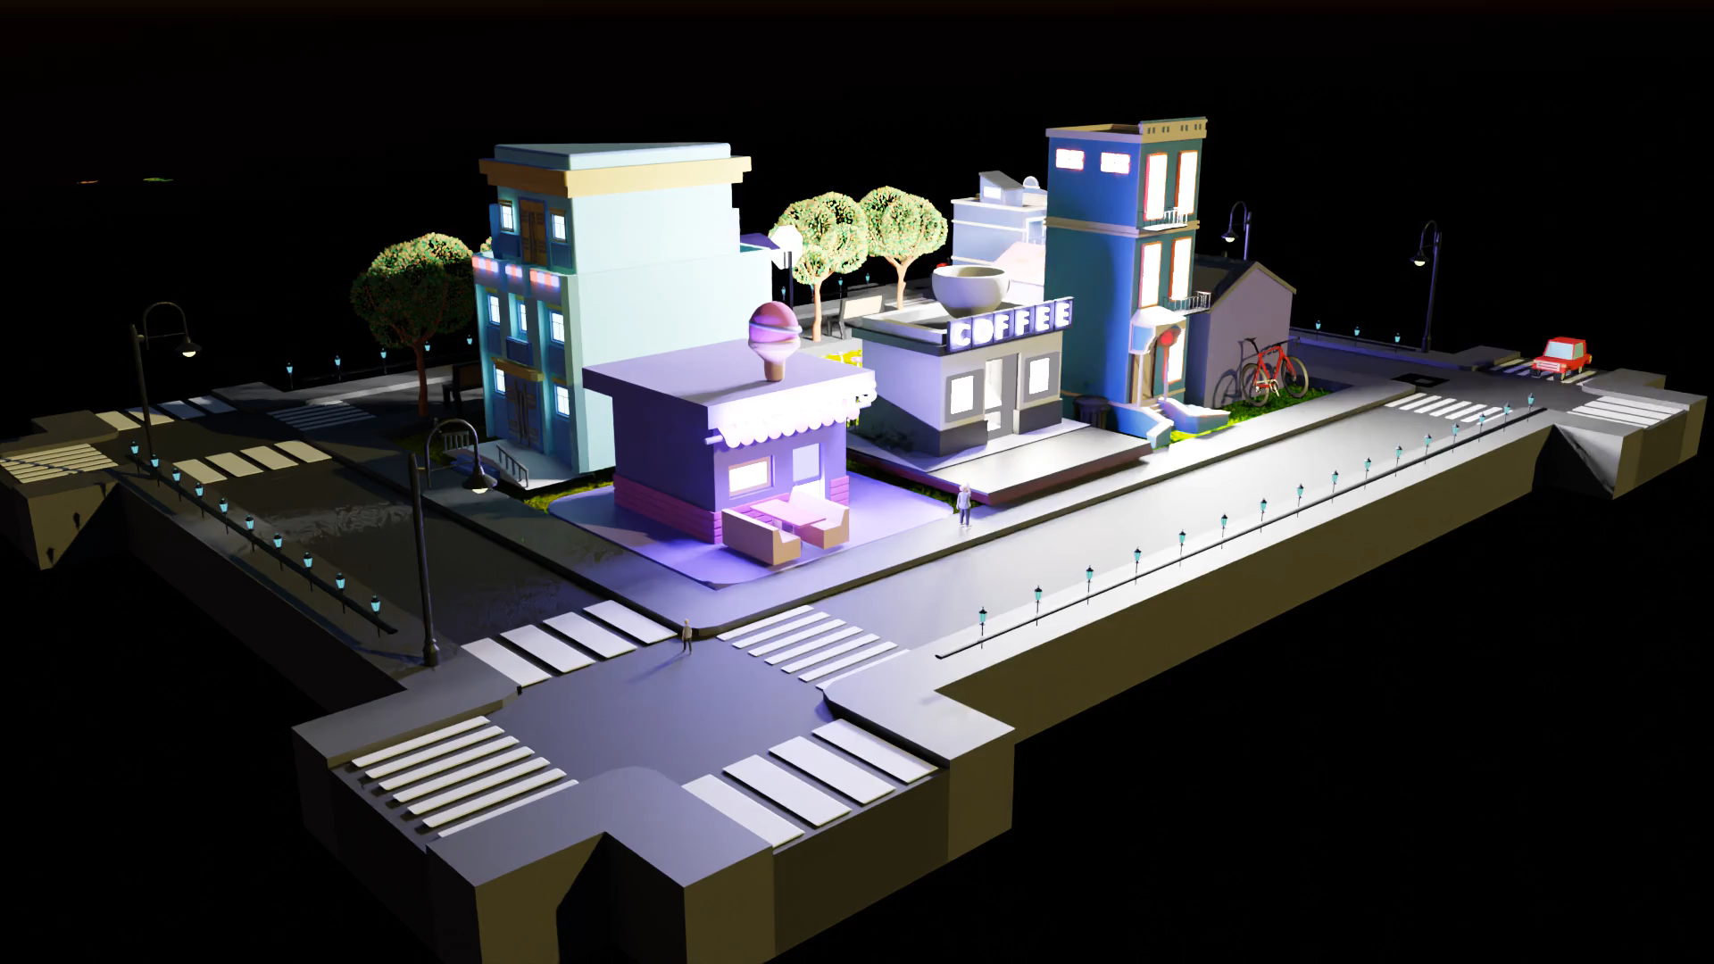
Shot one

Slide 5
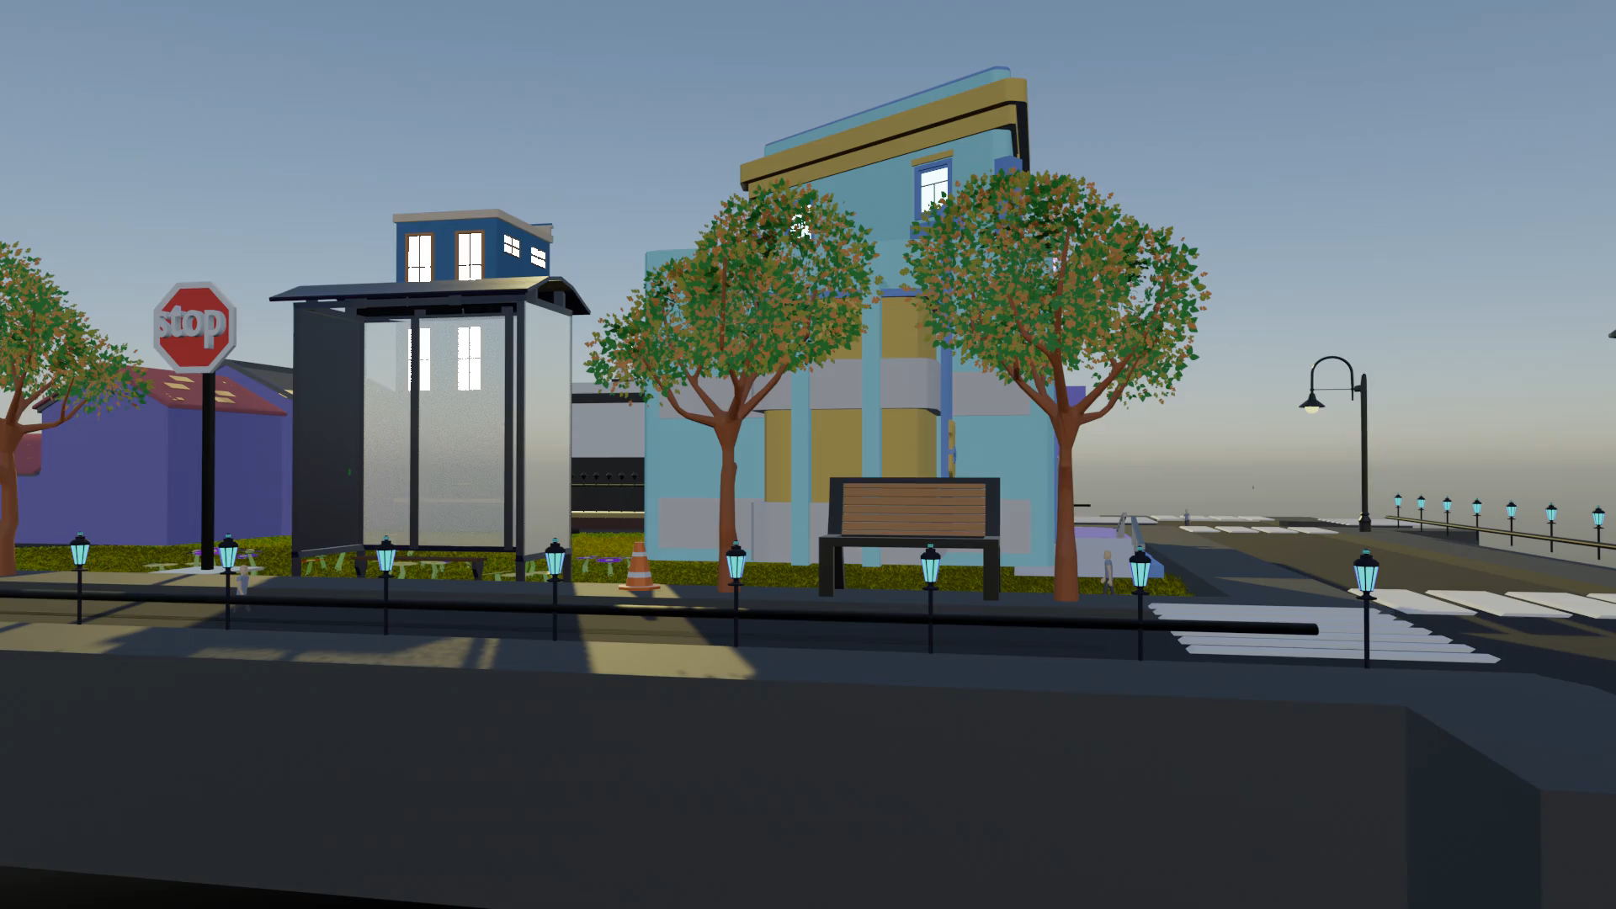
Shot two

Slide 6
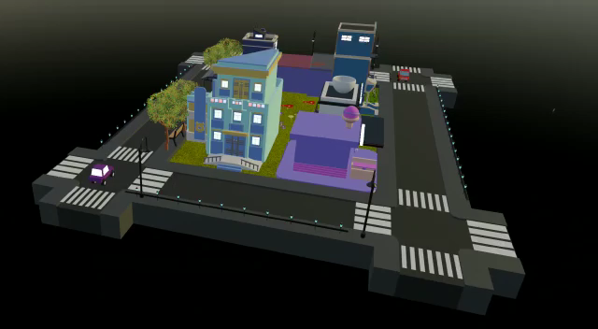
Shot three

Slide 7
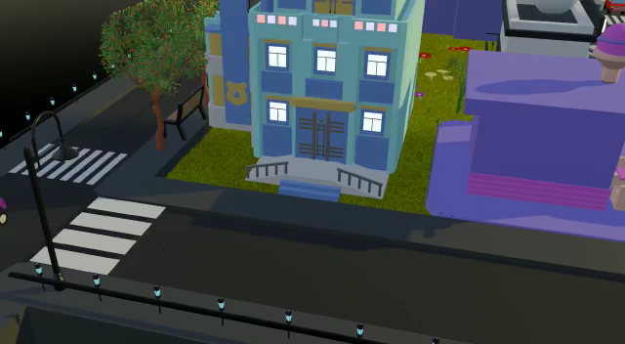
Shot four

Slide 8
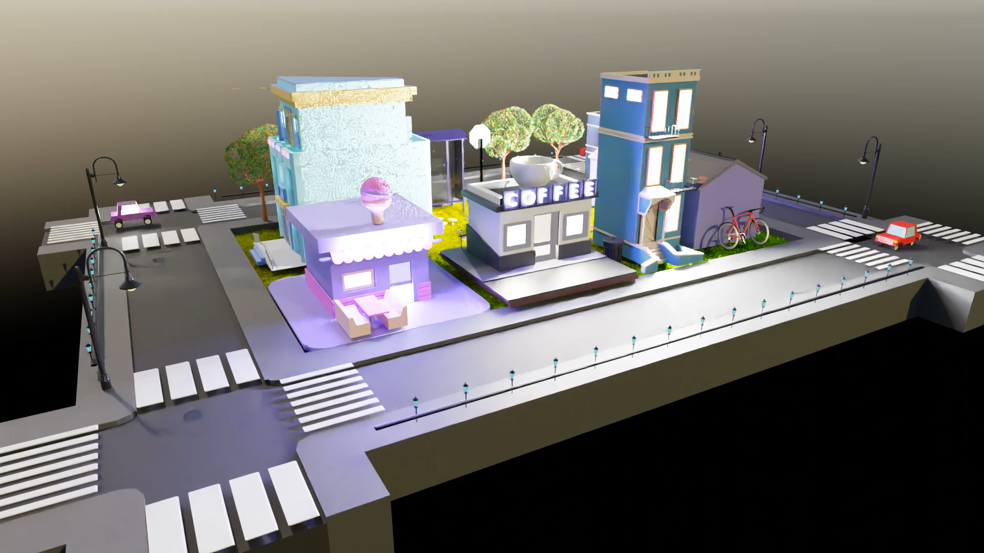
Shot five

Slide 9
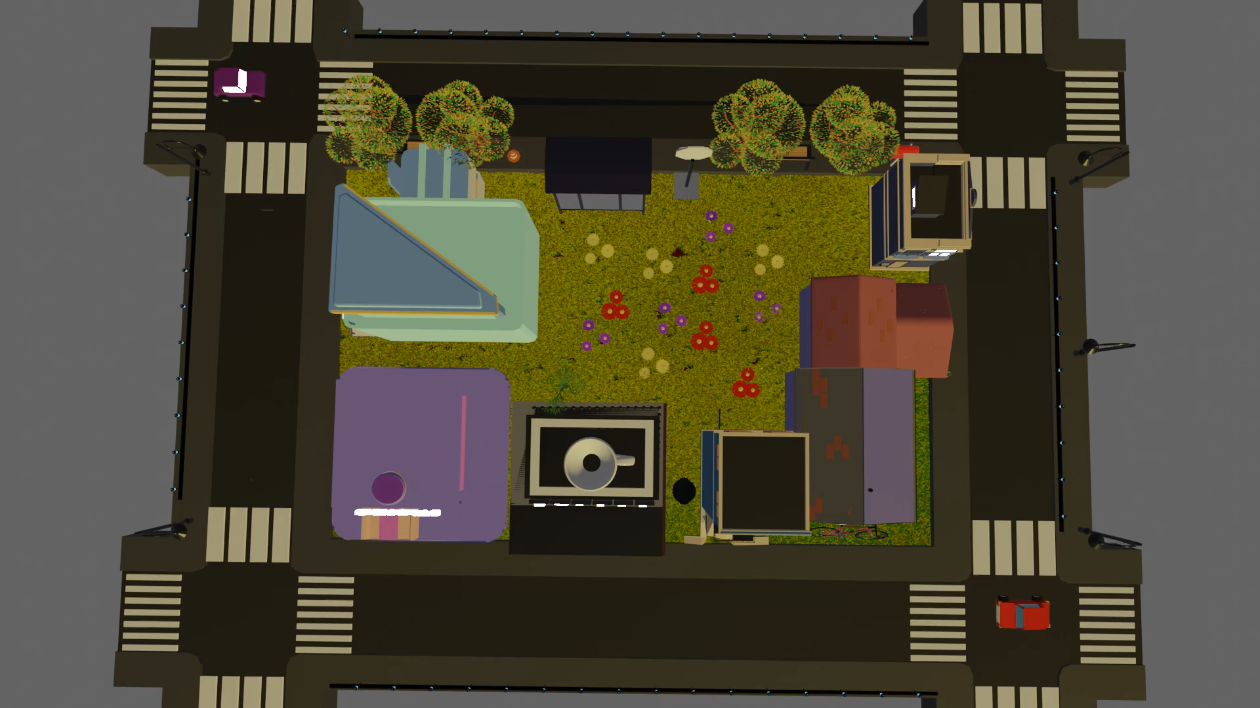
Shot six

Slide 10
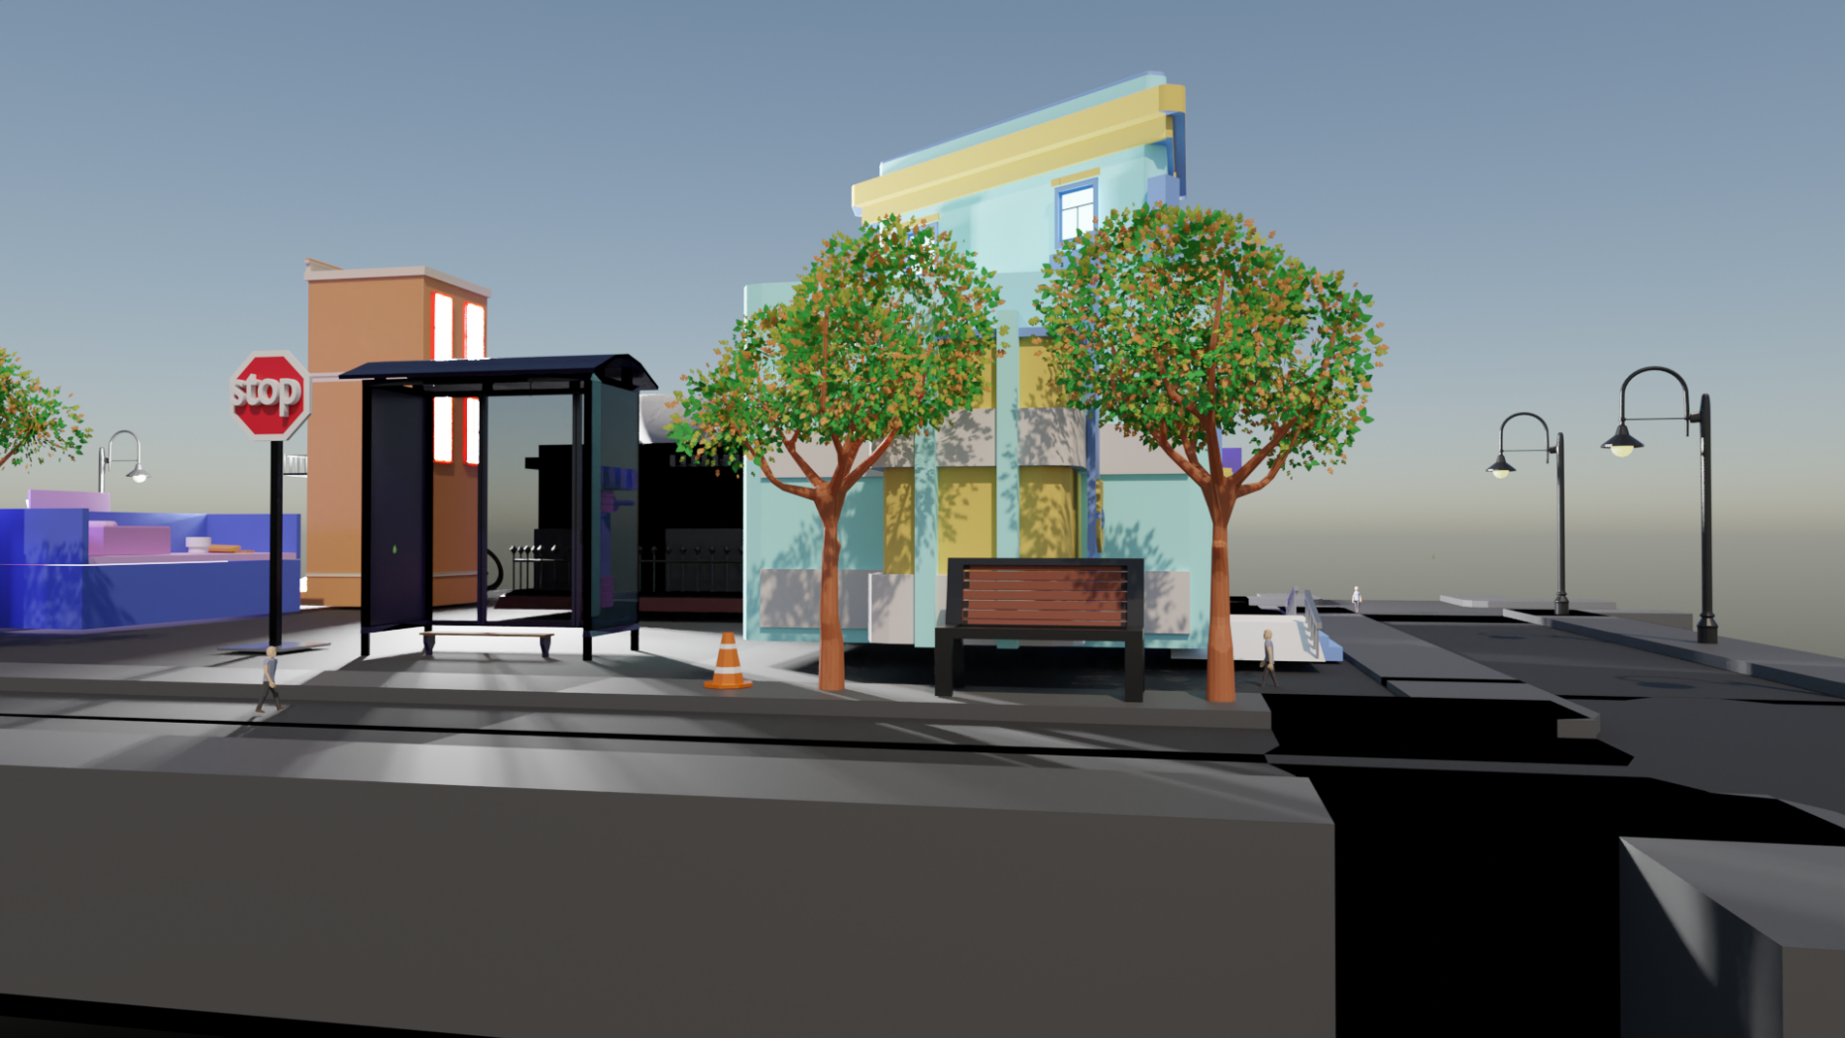
View ( 1 ) calming morning walk

Slide 11
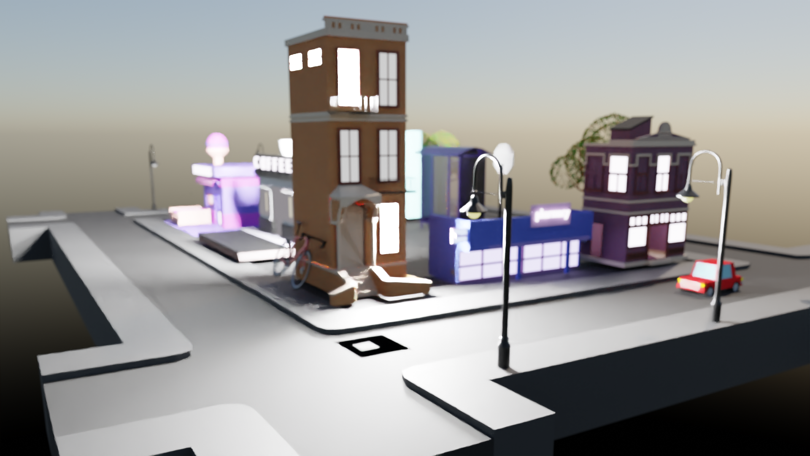
View ( 2 ) Foggy Car Ride

Slide 12
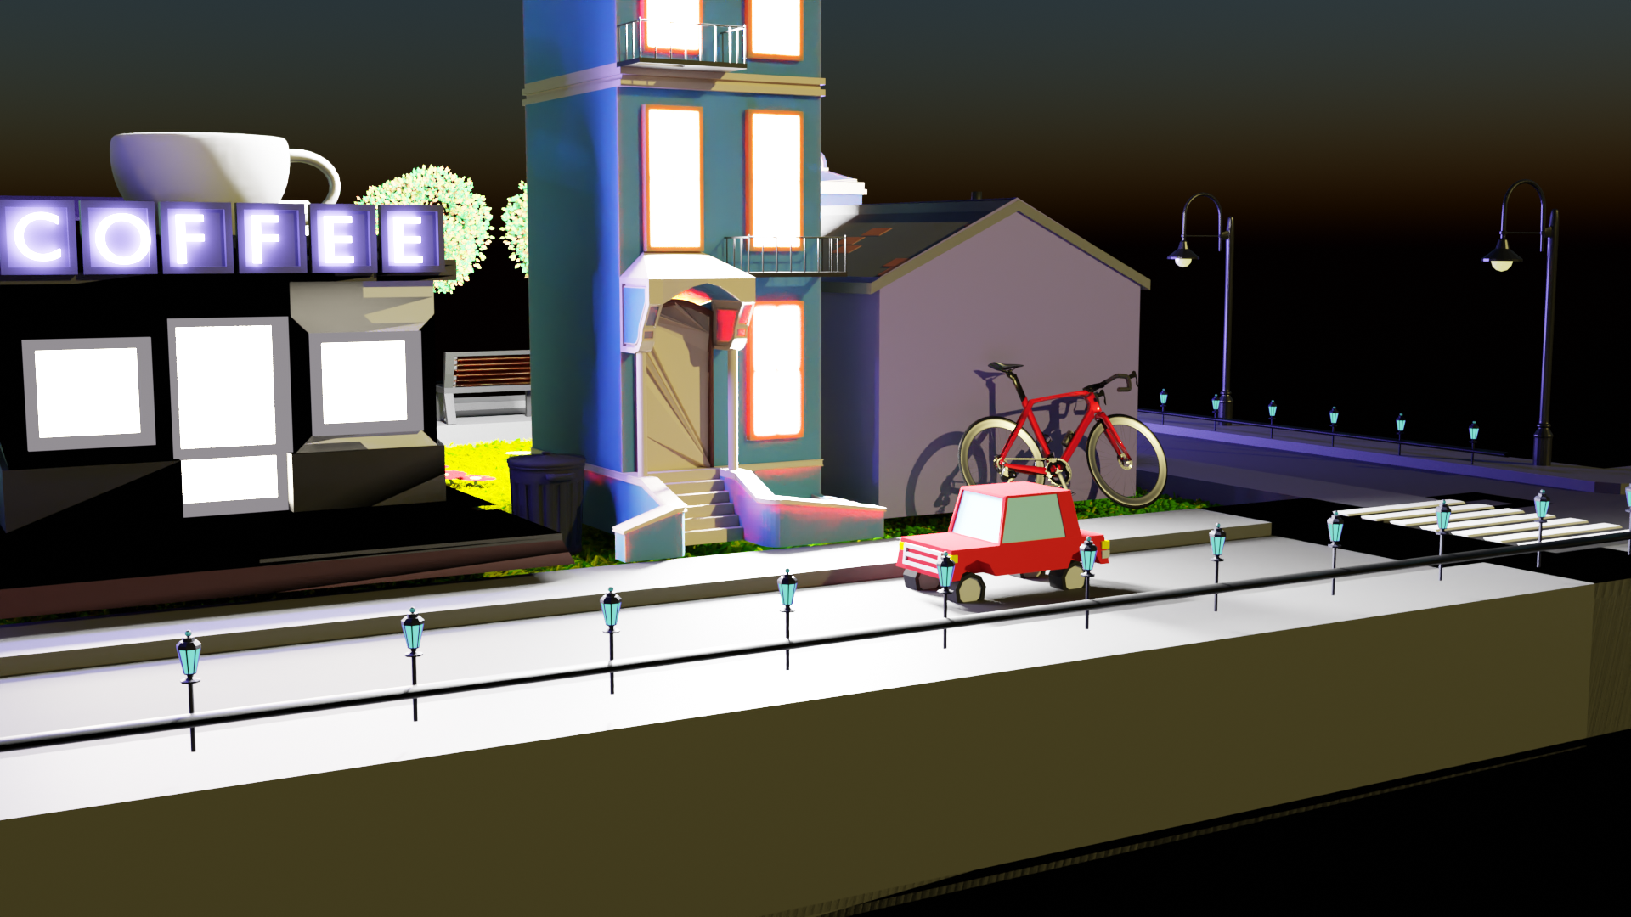
View ( 3 ) Evee Rendering

Slide 13
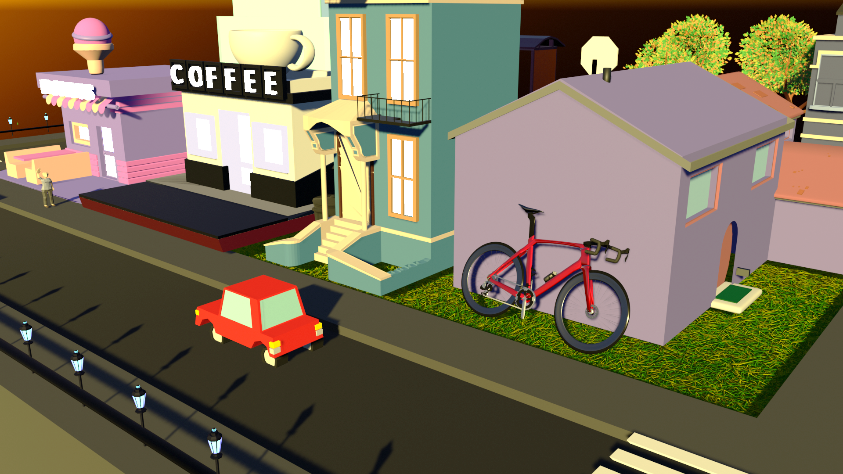
house
donuts shop
Coffee shop
Building
Car
Bicycle
View ( 4 ) midday coffee time

Slide 14
Taxonomy of our city
main components we used

Slide 15
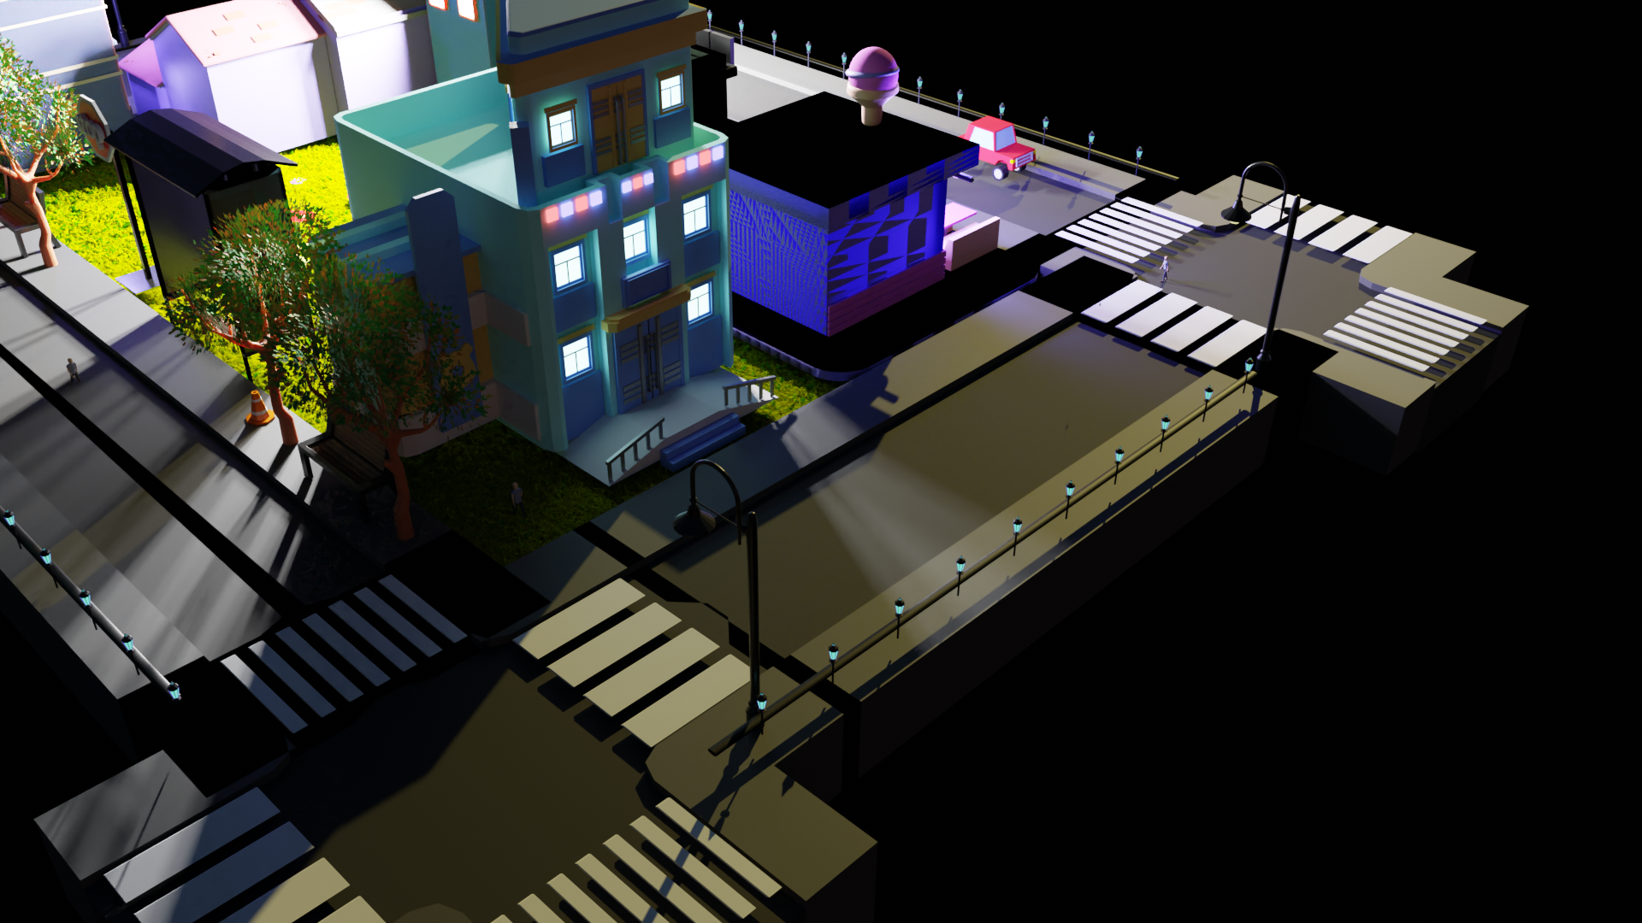
Building
tree
Classic street lightings
Road fence

Slide 16
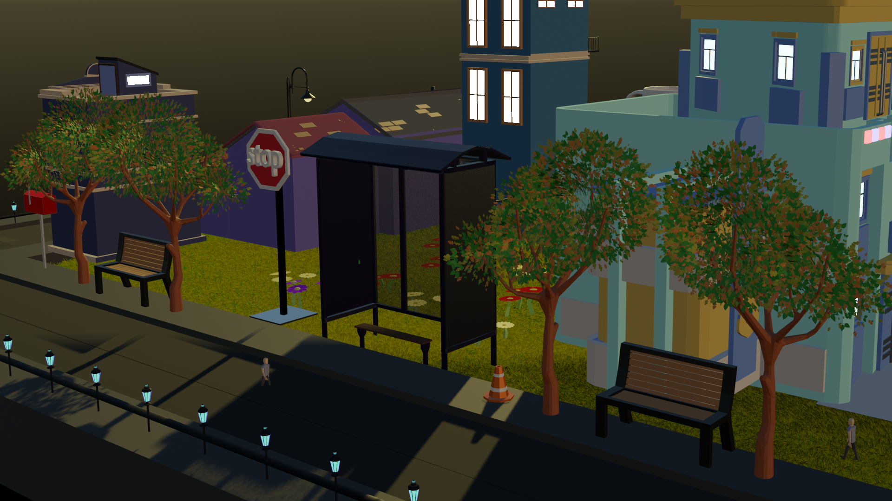
Stop station
Outdoor seating
Traffic cone
Outdoor seating

Slide 17
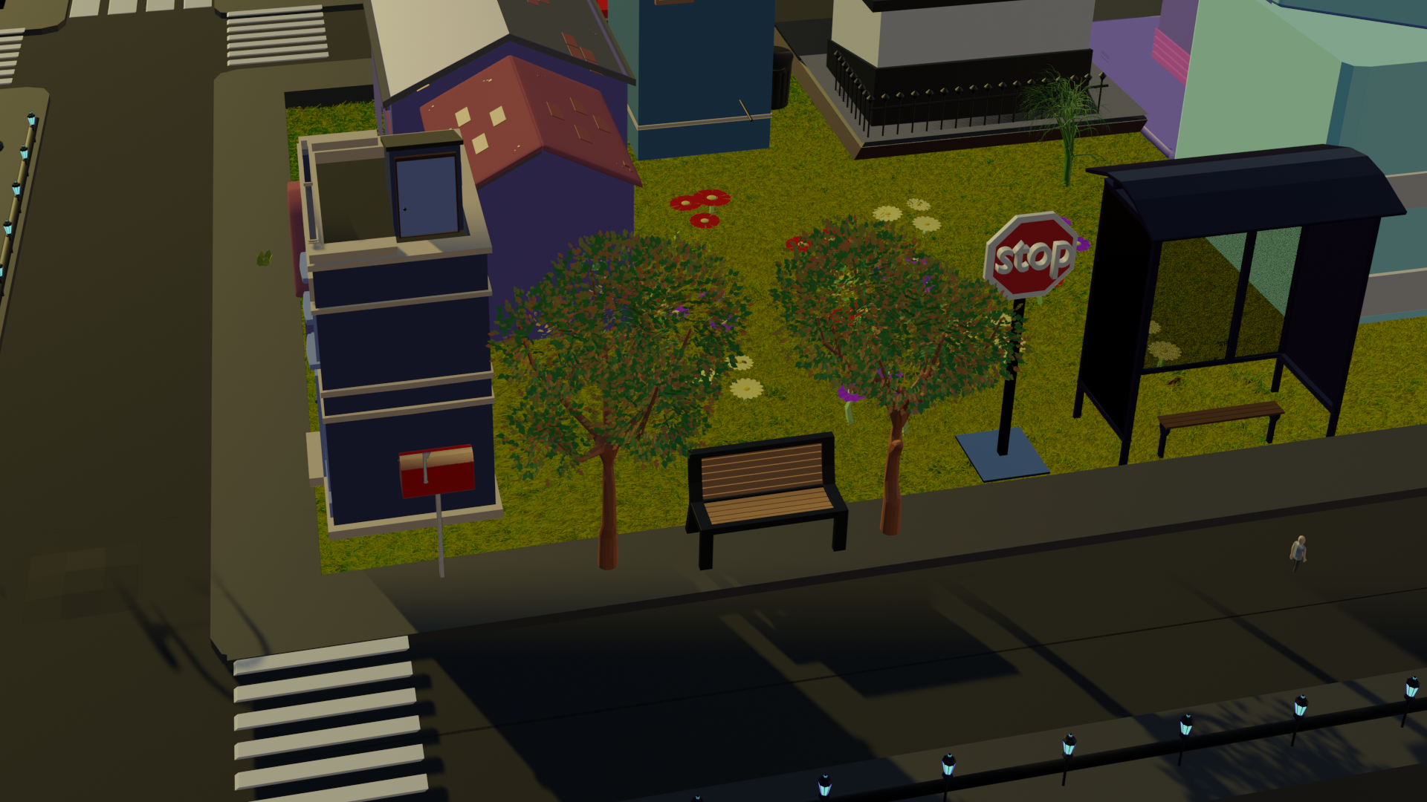
Flowers grounds
Mansion
house
seat
tree
Mailbox

Slide 18
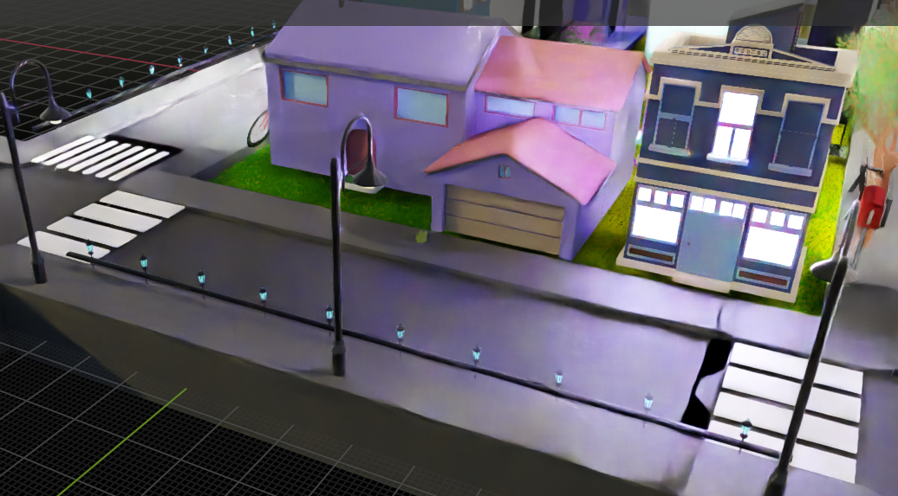
Cycle Engine Render

Slide 19
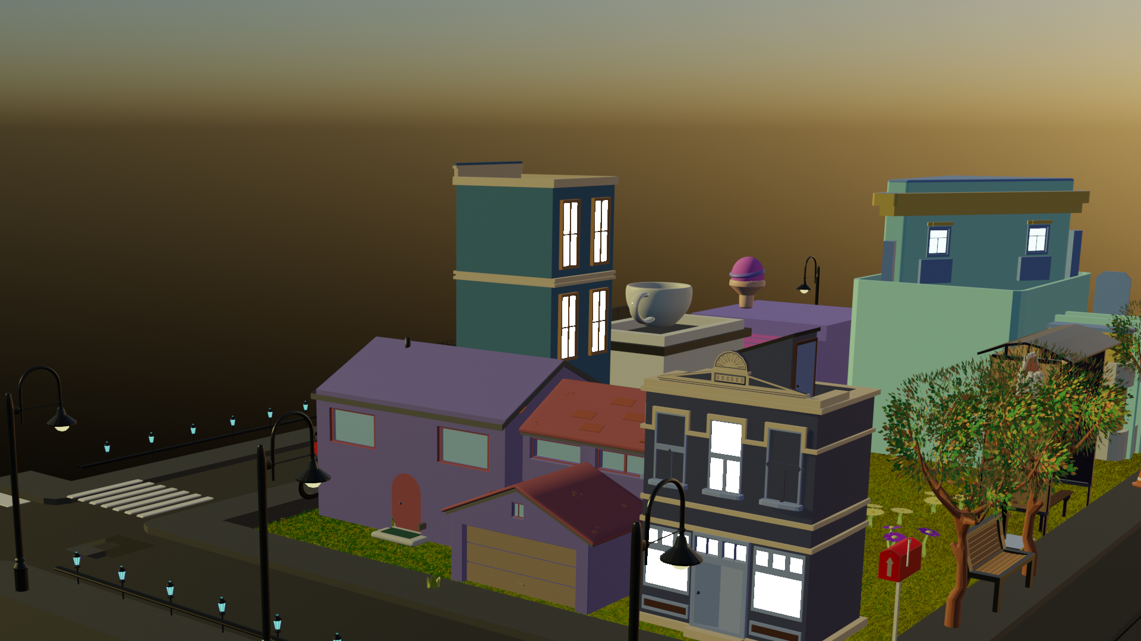
Evee Engine Render

Slide 20
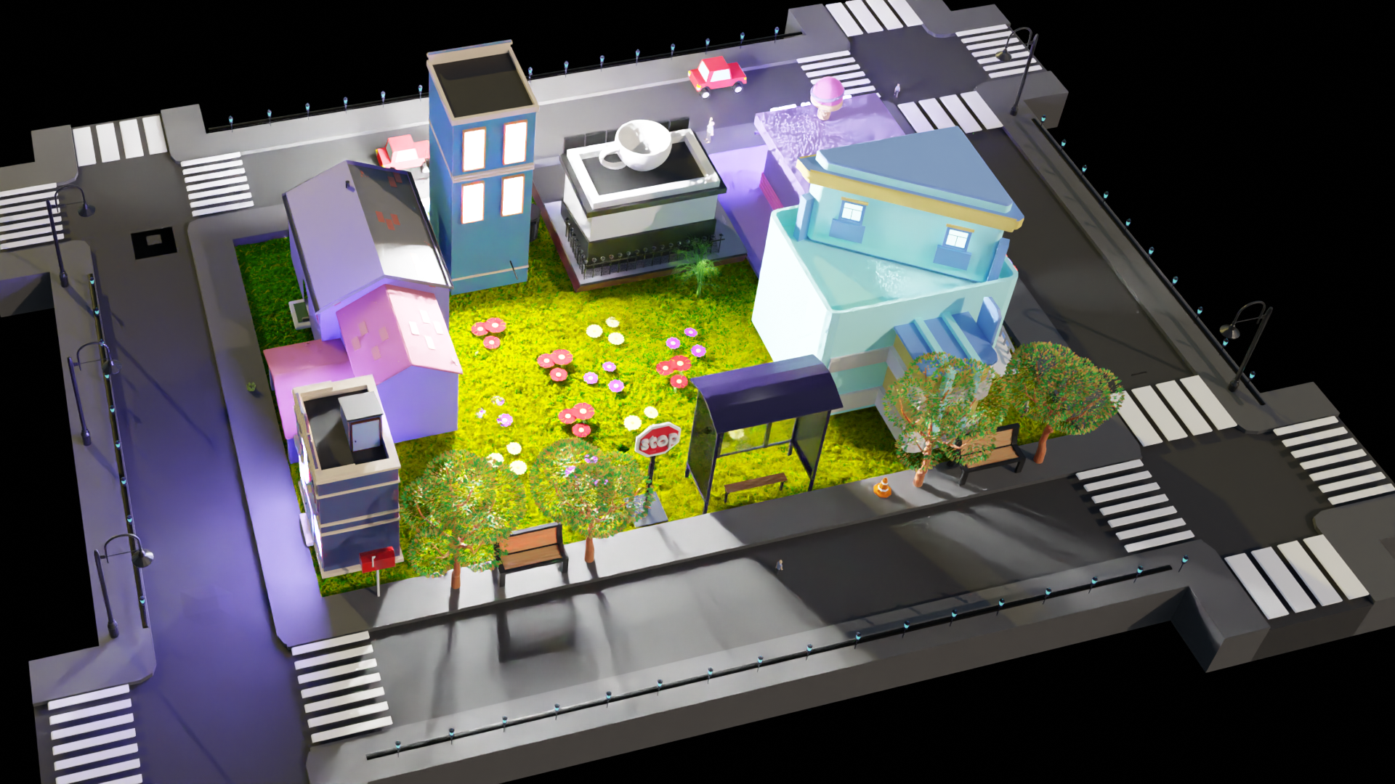
building
flowers
Far away look
flowers

Slide 21
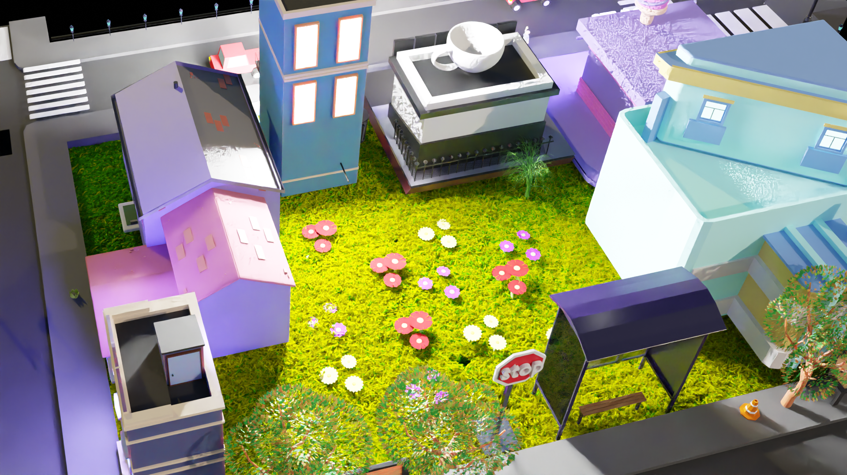
The ending <3

Slide 22

Who we are …

